Slide 1
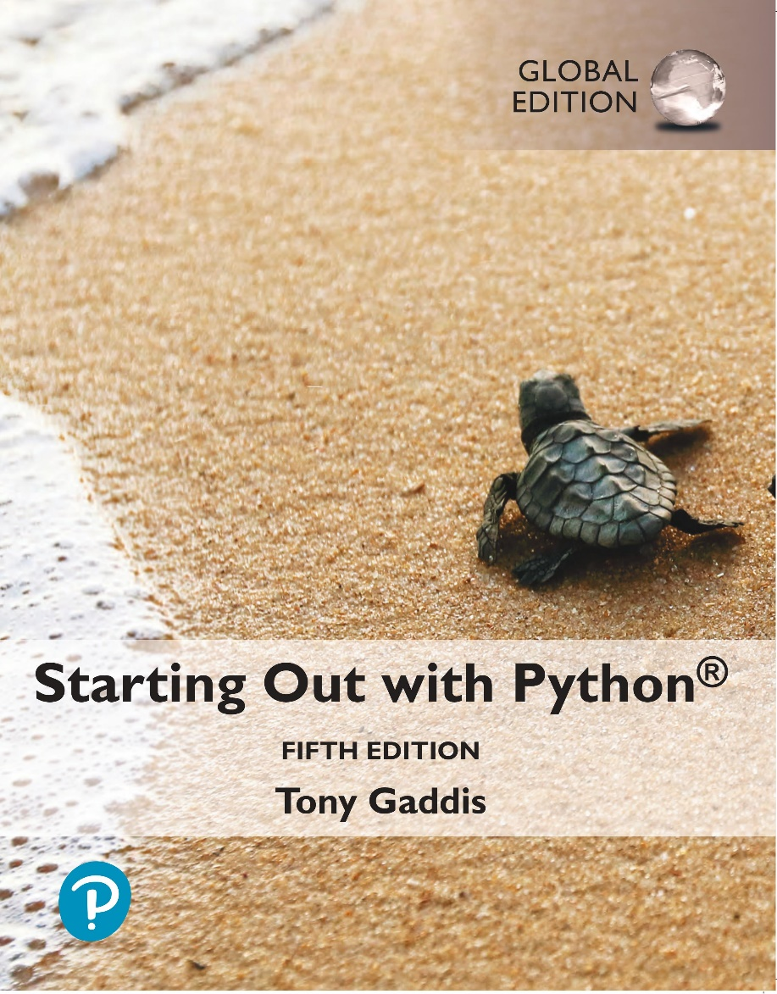
Starting out with Python
Fifth Edition, Global Edition
Chapter 6
Files and Exceptions
Copyright © 2022 Pearson Education, Ltd. All Rights Reserved.

Slide 2
Topics
Introduction to File Input and Output
Using Loops to Process Files
Processing Records
Exceptions

Slide 3
Introduction to File Input and Output (1 of 4)
For program to retain data between the times it is run, you must save the data
Data is saved to a file, typically on computer disk
Saved data can be retrieved and used at a later time
“Writing data to”: saving data on a file
Output file: a file that data is written to

Slide 4
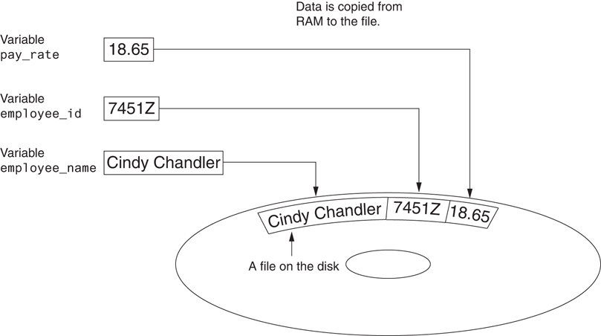
Introduction to File Input and Output (2 of 4)
Figure 6-1 Writing data to a file

Slide 5
Introduction to File Input and Output (3 of 4)
“Reading data from”: process of retrieving data from a file
Input file: a file from which data is read
Three steps when a program uses a file
Open the file
Process the file
Close the file

Slide 6
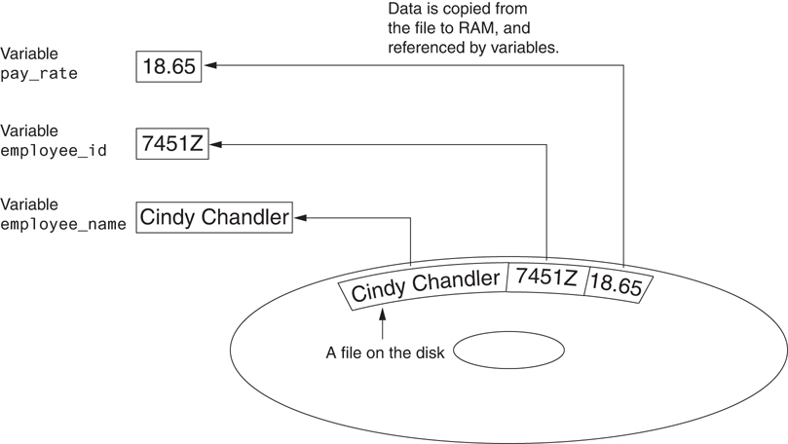
Introduction to File Input and Output (4 of 4)
Figure 6-2 Reading data from a file

Slide 7
Types of Files and File Access Methods
In general, two types of files
Text file: contains data that has been encoded as text
Binary file: contains data that has not been converted to text
Two ways to access data stored in file
Sequential access: file read sequentially from beginning to end, can’t skip ahead
Direct access: can jump directly to any piece of data in the file

Slide 8
Filenames and File Objects (1 of 2)
Filename extensions: short sequences of characters that appear at the end of a filename preceded by a period
Extension indicates type of data stored in the file
File object: object associated with a specific file
Provides a way for a program to work with the file: file object referenced by a variable

Slide 9
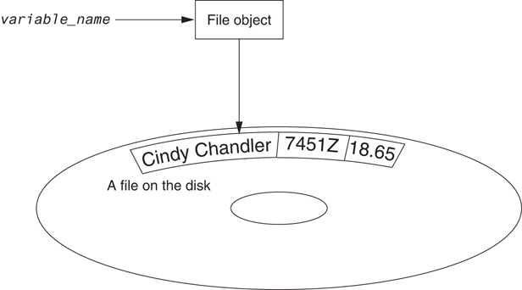
Filenames and File Objects (2 of 2)
Figure 6-4 A variable name references a file object that is associated with a file

Slide 10
Opening a File (1 of 2)
open function: used to open a file
Creates a file object and associates it with a file on the disk
General format:
file_object = open(filename, mode)
Mode: string specifying how the file will be opened
Example: reading only ('r'), writing ('w'), and appending ('a')

Slide 11
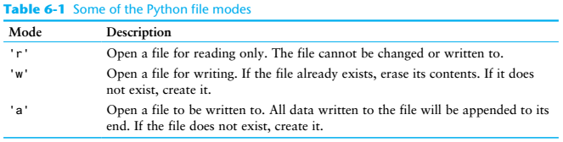
Opening a File (2 of 2)

Slide 12
Specifying the Location of a File
If open function receives a filename that does not contain a path, assumes that file is in same directory as program
If program is running and file is created, it is created in the same directory as the program
Can specify alternative path and file name in the open function argument
Prefix the path string literal with the letter r

Slide 13
Writing Data to a File (1 of 2)
Method: a function that belongs to an object
Performs operations using that object
File object’s write method used to write data to the file
Format: file_variable.write(string)
File should be closed using file object close method
Format: file_variable.close()

Slide 14
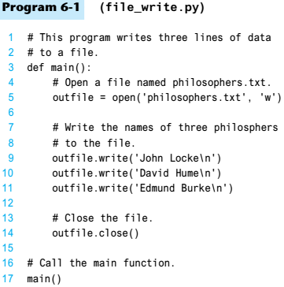
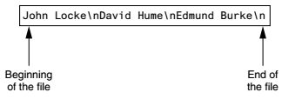
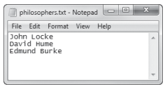
Writing Data to a File (2 of 2)

Slide 15
Reading Data From a File (1 of 2)
read method: file object method that reads entire file contents into memory
Only works if file has been opened for reading
Contents returned as a string
readline method: file object method that reads a line from the file
Line returned as a string, including '\n'
Read position: marks the location of the next item to be read from a file

Slide 16
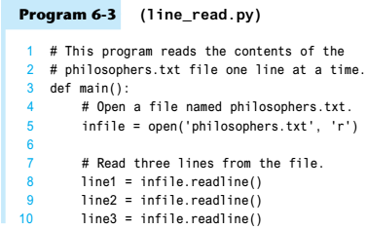
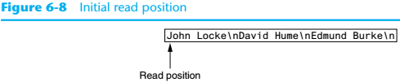

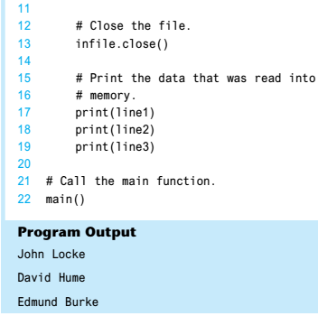
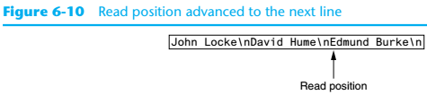
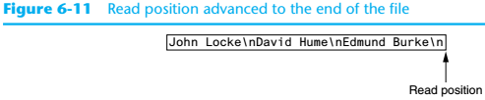
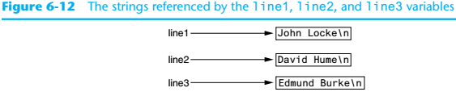
Reading Data From a File (2 of 2)

Slide 17
Concatenating a Newline to and Stripping it From a String (1 of 4)
In most cases, data items written to a file are values referenced by variables
Usually necessary to concatenate a '\n' to data before writing it
Carried out using the + operator in the argument of the write method

Slide 18
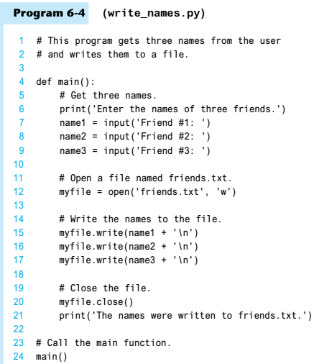
Concatenating a Newline to and Stripping it From a String (2 of 4)

Slide 19
Concatenating a Newline to and Stripping it From a String (3 of 4)
In many cases need to remove '\n' from string after it is read from a file
rstrip method: string method that strips specific characters from end of the string

Slide 20
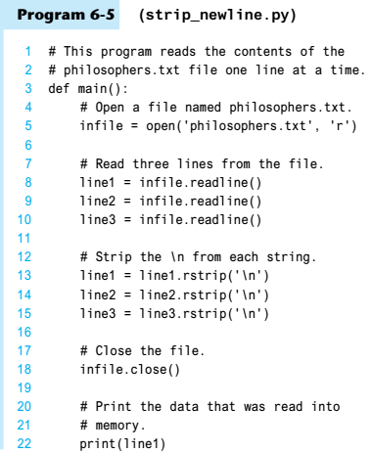
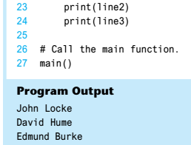
Concatenating a Newline to and Stripping it From a String (4 of 4)

Slide 21
Appending Data to an Existing File
When open file with 'w' mode, if the file already exists it is overwritten
To append data to a file use the 'a'mode
If file exists, it is not erased, and if it does not exist it is created
Data is written to the file at the end of the current contents

Slide 22
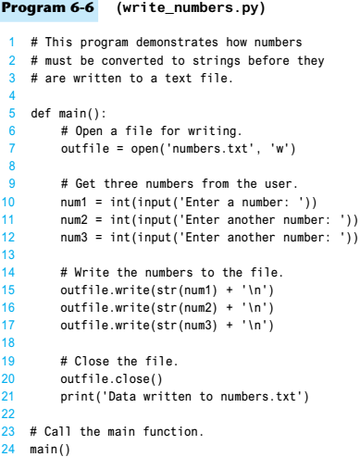
Writing and Reading Numeric Data (1 of 2)
Numbers must be converted to strings before they are written to a file
str function: converts value to string

Slide 23
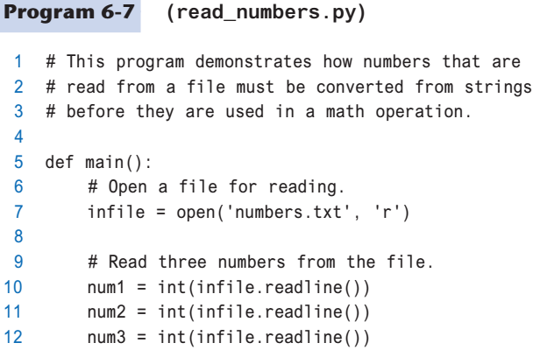
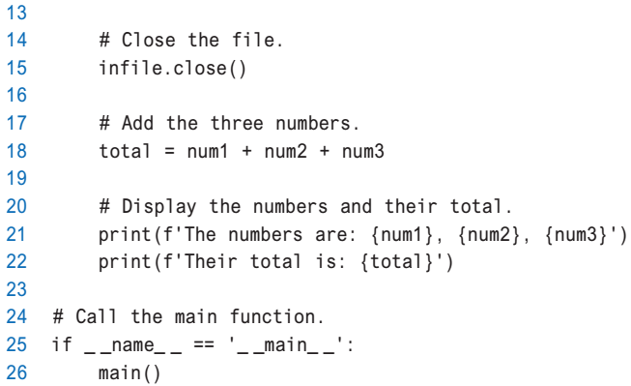
Writing and Reading Numeric Data (2 of 2)
Number are read from a text file as strings
Must be converted to numeric type in order to perform mathematical operations
Use int and float functions to convert string to numeric value

Slide 24
Using Loops to Process Files (1 of 3)
Files typically used to hold large amounts of data
Loop typically involved in reading from and writing to a file
Often the number of items stored in file is unknown
The readline method uses an empty string as a sentinel when end of file is reached
Can write a while loop with the condition
while line != ''

Slide 25
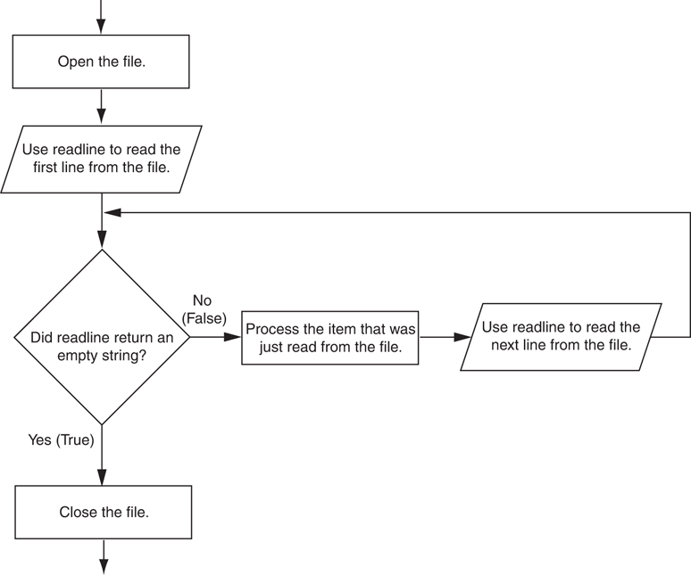
Using Loops to Process Files (2 of 3)
Figure 6-17 General logic for detecting the end of a file

Slide 26
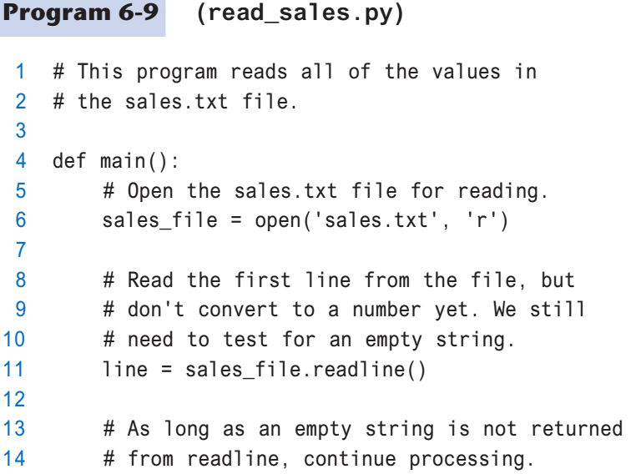
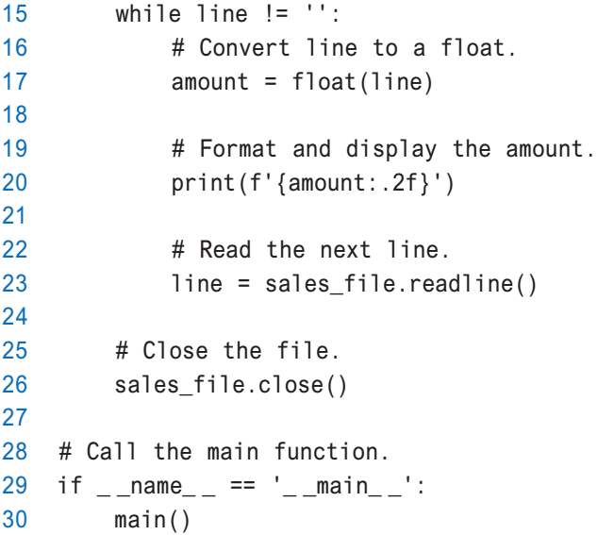
Using Loops to Process Files (3 of 3)

Slide 27
Using Python’s for Loop to Read Lines (1 of 2)
Python allows the programmer to write a for loop that automatically reads lines in a file and stops when end of file is reached
Format: for line in file_object:
statements
The loop iterates once over each line in the file

Slide 28
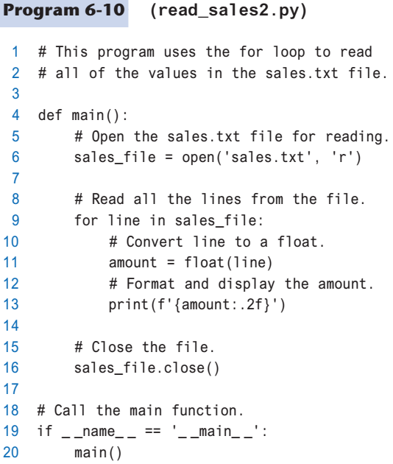
Using Python’s for Loop to Read Lines (2 of 2)

Slide 29
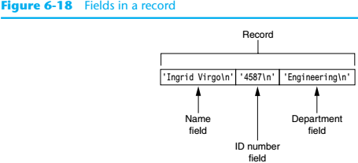
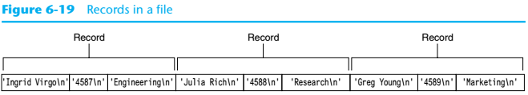
Processing Records (1 of 2)
Record: set of data that describes one item
Field: single piece of data within a record
Write record to sequential access file by writing the fields one after the other
Read record from sequential
access file by reading each
field until record complete

Slide 30
Processing Records (2 of 2)
When working with records, it is also important to be able to:
Add records
Display records
Search for a specific record
Modify records
Delete records

Slide 31
Exceptions (1 of 7)
Exception: error that occurs while a program is running
Usually causes program to abruptly halt
Traceback: error message that gives information regarding line numbers that caused the exception
Indicates the type of exception and brief description of the error that caused exception to be raised

Slide 32
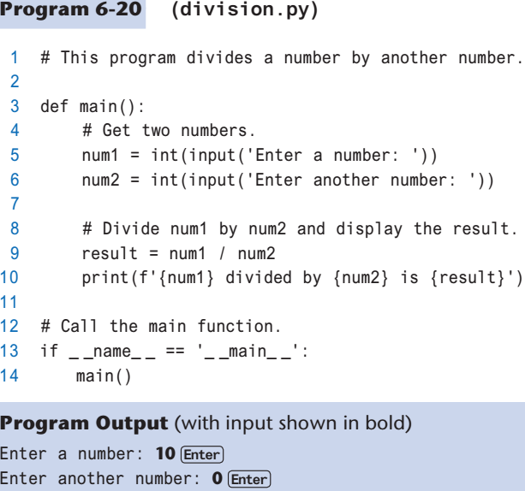
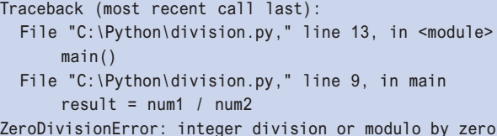
Exceptions (2 of 7)

Slide 33
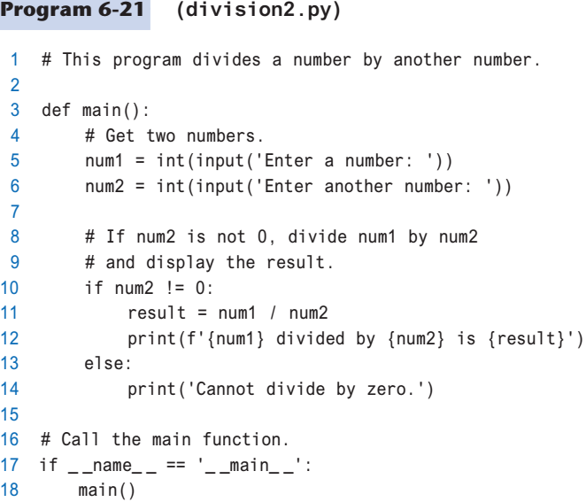
Exceptions (3 of 7)
Many exceptions can be prevented by careful coding
Example: input validation
Usually involve a simple decision construct

Slide 34
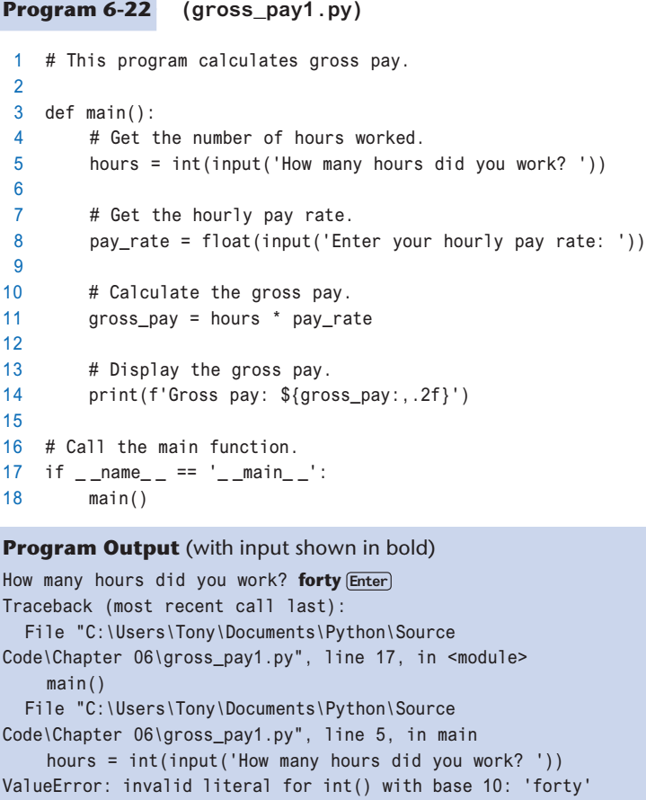
Exceptions (4 of 7)
Some exceptions cannot be avoided by careful coding
Examples
Trying to convert non-numeric string to an integer
Trying to open for reading a file that doesn’t exist

Slide 35
Exceptions (5 of 7)
Exception handler: code that responds when exceptions are raised and prevents program from crashing
In Python, written as try/except statement
General format: try:
statements
except exceptionName:
statements
Try suite: statements that can potentially raise an exception
Handler: statements contained in except block

Slide 36
Exceptions (6 of 7)
If statement in try suite raises exception:
Exception specified in except clause:
Handler immediately following except clause executes
Continue program after try/except statement
Other exceptions:
Program halts with traceback error message
If no exception is raised, handlers are skipped

Slide 37
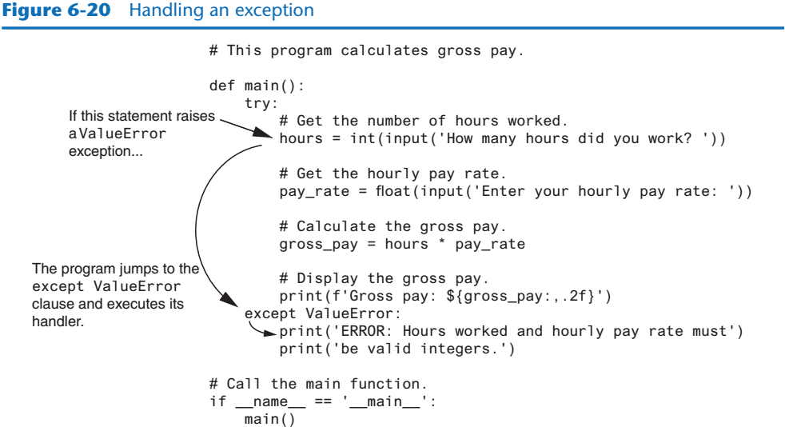
Exceptions (7 of 7)

Slide 38
Handling Multiple Exceptions (1 of 2)
Often code in try suite can throw more than one type of exception
Need to write except clause for each type of exception that needs to be handled
An except clause that does not list a specific exception will handle any exception that is raised in the try suite
Should always be last in a series of except clauses

Slide 39
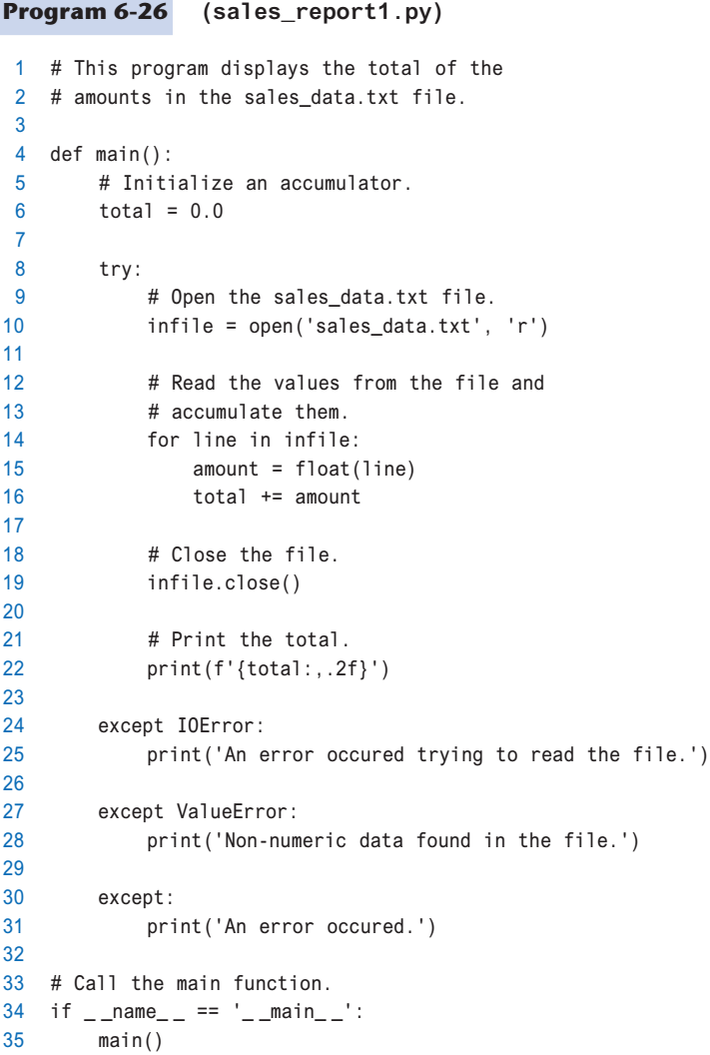
Handling Multiple Exceptions (2 of 2)

Slide 40
Displaying an Exception’s Default Error Message (1 of 2)
Exception object: object created in memory when an exception is thrown
Usually contains default error message pertaining to the exception
Can assign the exception object to a variable in an except clause
Example: except ValueErroraserr:
Can pass exception object variable to print function to display the default error message

Slide 41
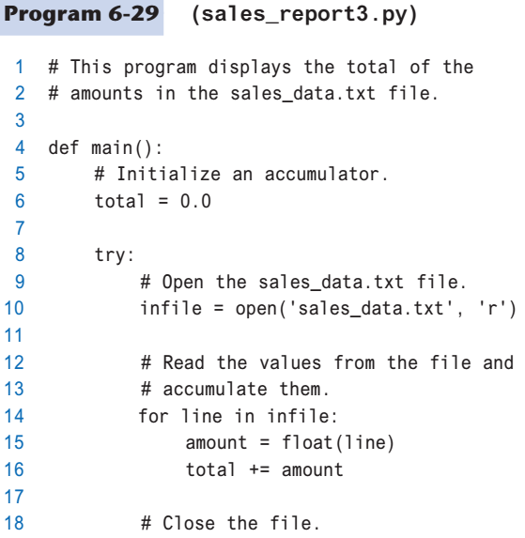
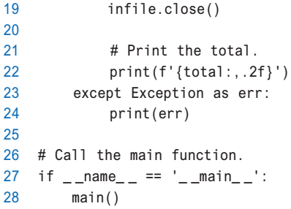
Displaying an Exception’s Default Error Message (2 of 2)

Slide 42
The else Clause (1 of 2)
try/except statement may include an optional else clause, which appears after all the except clauses
Aligned with try and except clauses
Syntax similar to else clause in decision structure
Else suite: block of statements executed after statements in try suite, only if no exceptions were raised
If exception was raised, the else suite is skipped

Slide 43
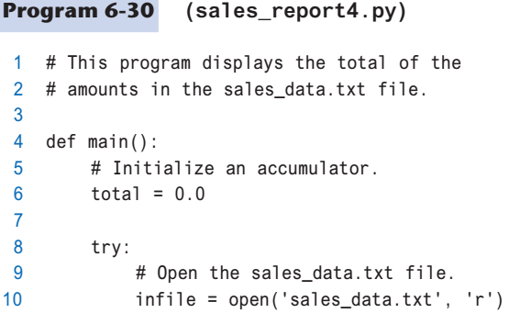
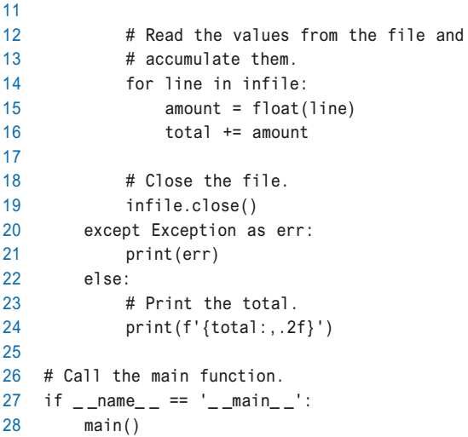
The else Clause (2 of 2)

Slide 44
The finally Clause
try/except statement may include an optional finally clause, which appears after all the except clauses
Aligned with try and except clauses
General format: finally:
statements
Finally suite: block of statements after the finally clause
Execute whether an exception occurs or not
Purpose is to perform cleanup before exiting

Slide 45
What If an Exception Is Not Handled?
Two ways for exception to go unhandled:
No except clause specifying exception of the right type
Exception raised outside a try suite
In both cases, exception will cause the program to halt
Python documentation provides information about exceptions that can be raised by different functions

Slide 46
Summary
This chapter covered:
Types of files and file access methods
Filenames and file objects
Writing data to a file
Reading data from a file and determining when the end of the file is reached
Processing records
Exceptions, including:
Traceback messages
Handling exceptions

